Slide 1
WEATHER PARTNERSHIP
Enhancing Emergency Response with Real-Time Weather Intelligence
Dan Gallagher
BARON SALES ENGINEER | METEOROLOGIST
JANUARY 15, 2025

Slide 2
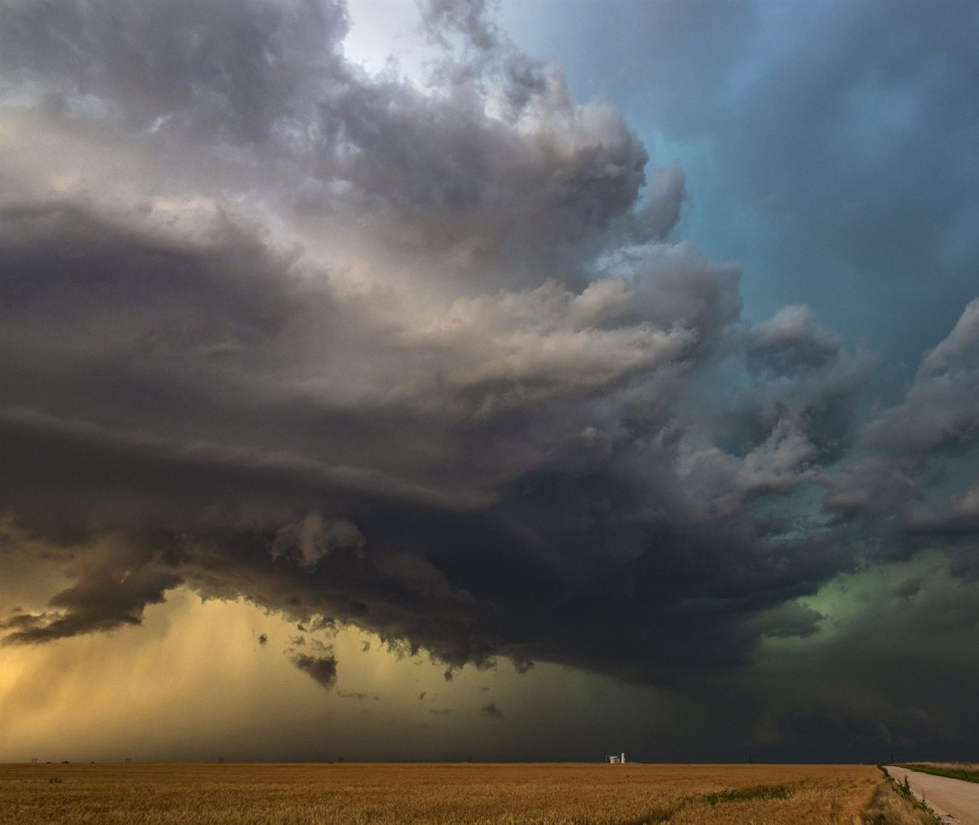
Global weather technology company specialized in providing weather insights for business challenges
Headquartered in Huntsville, AL
Serves weather data to over 50,000 customers
102 exclusive weather data products
Baron technology is embedded into the NWS radar network
Mission to protect people and places
Dedicated to the science of weather
Committed to excellent customer service

Slide 3
WEATHER PARTNERSHIP
Key Benefits
Enhanced Situational Awareness Real-time weather data and advanced forecasting from Baron Weather directly within WebEOC
Improved Decision-Making Access to street-level weather intelligence on the location, timing, and type of weather impact will support more informed and timely decisions during critical incidents
Increased Operational Efficiency Seamless integration of weather data with WebEOC's incident management tools will streamline workflows and enhance coordination among emergency response teams

Slide 4
BARON WEATHER DATA CATALOGUE
Key Benefits
Vast catalogue of weather and its impacts
Highly local with frequent updates
Unique data layers
No analysis or interpretation necessary
State of the science
Decades of experience

Slide 5
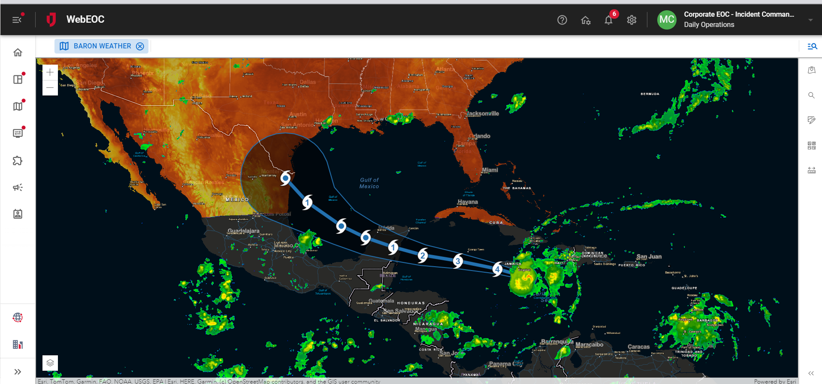

Slide 7
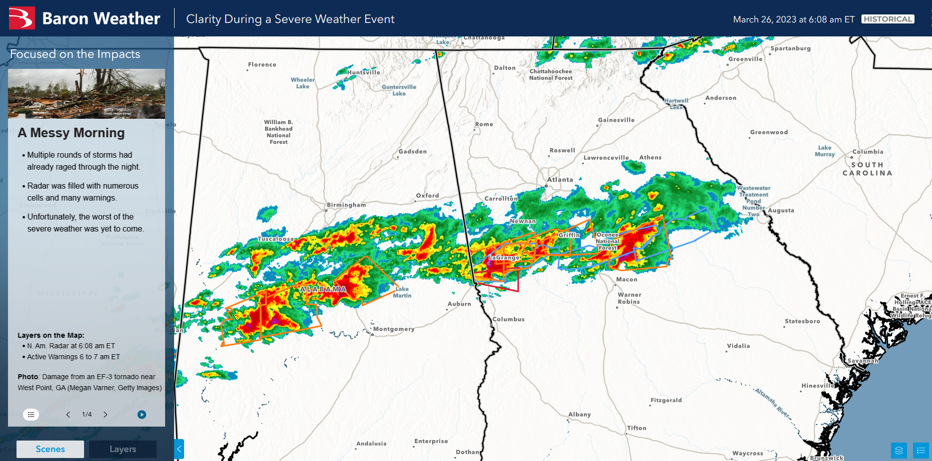

Slide 8
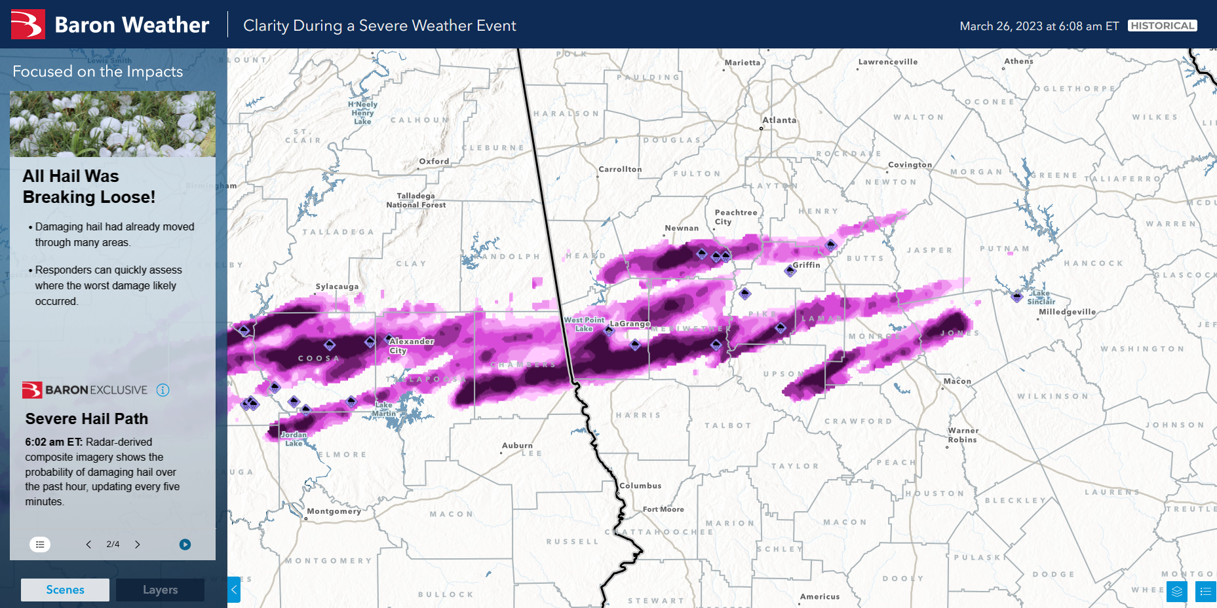

Slide 9
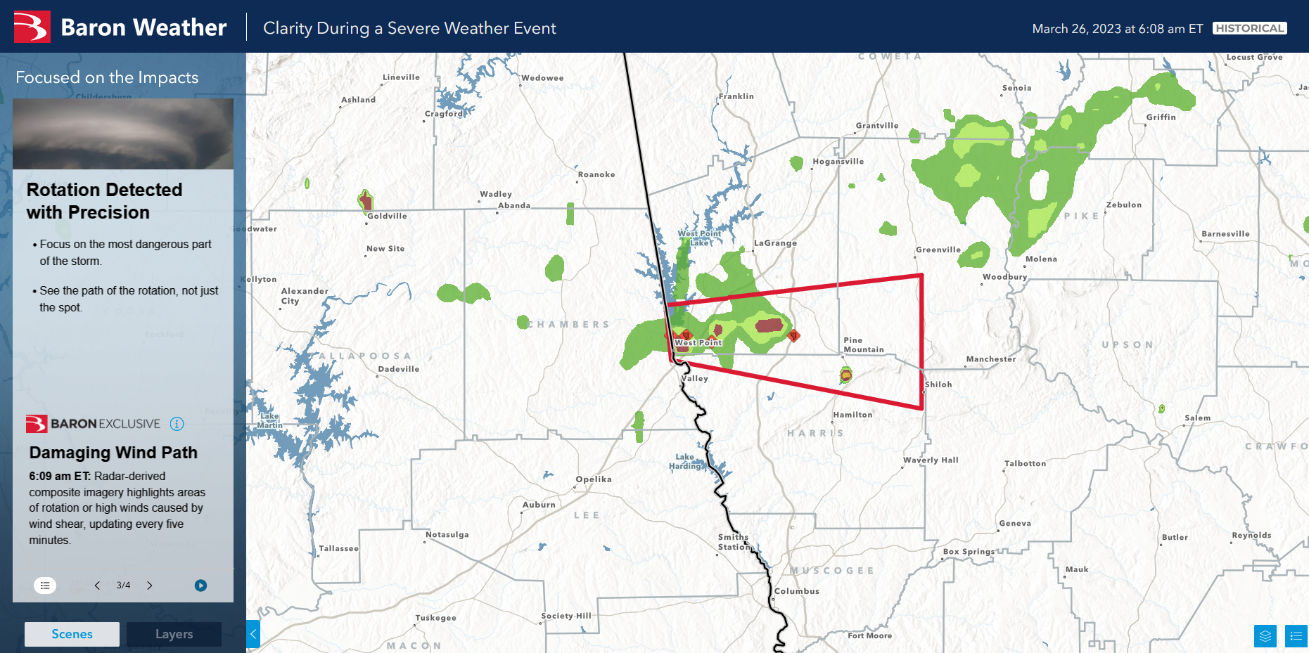

Slide 10
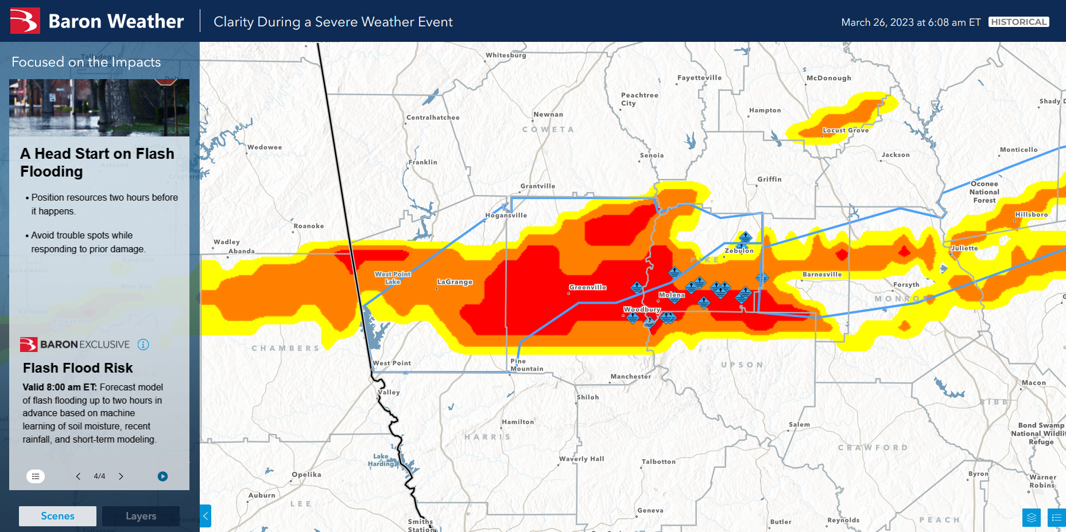

Slide 11
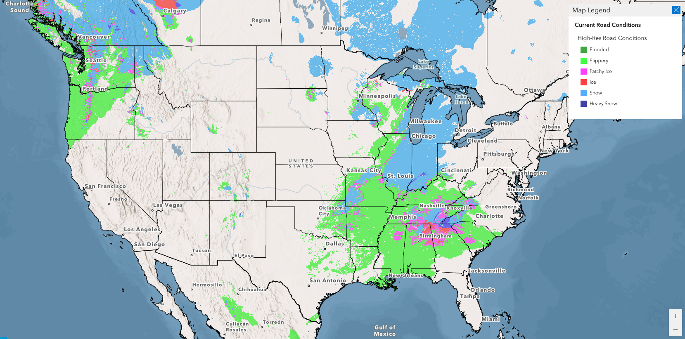

Slide 12
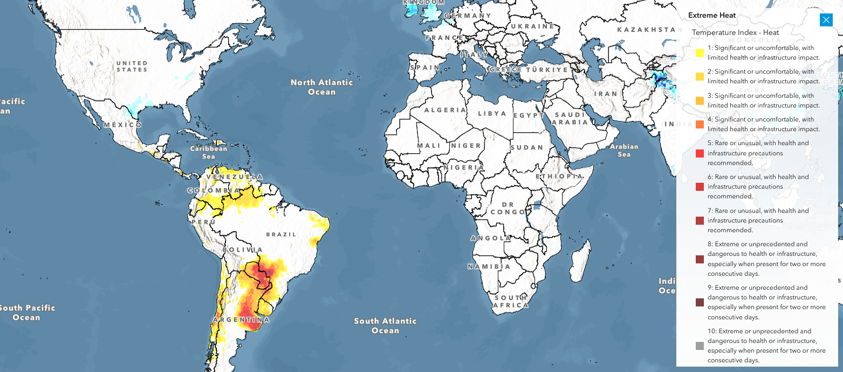

Slide 13
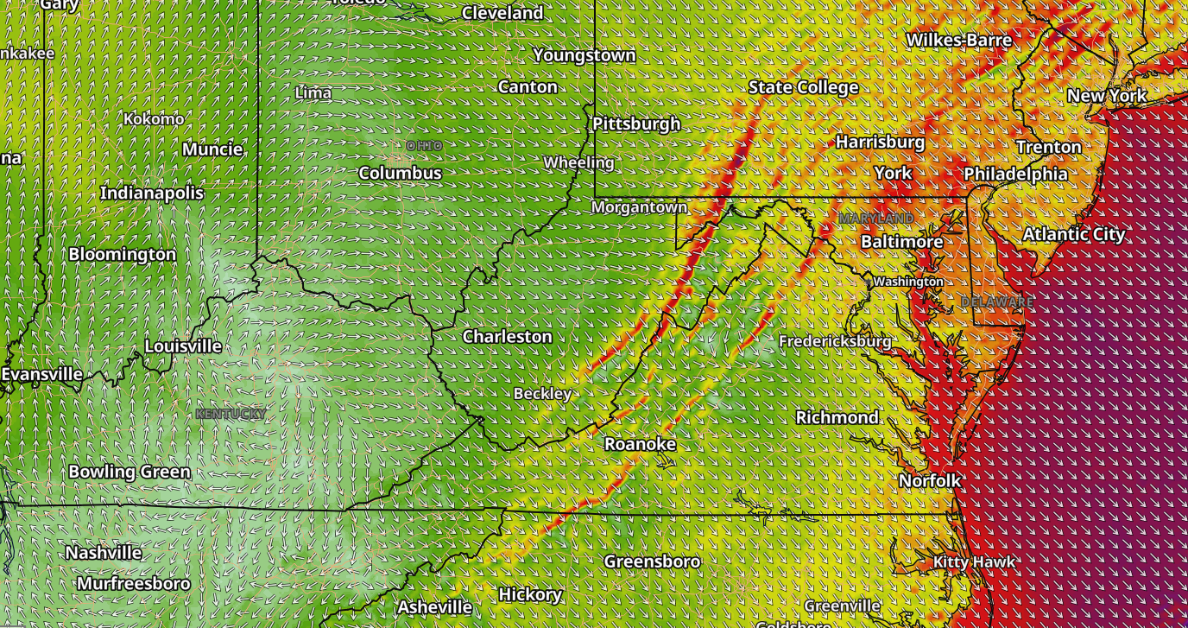

Slide 14
Public Safety Package
CURRENT | FORECAST
Hi-Res North American Radar | Flash Flood Risk
Lightning | Wind Speed – Baron Forecast Model
Storm Vectors | Wind Direction – Baron Forecast Model
Wind Speed | Wind Gusts – Baron Forecast Model
Wind Gusts | Temperature – Baron Forecast Model
Damaging Wind Path | Precipitation (Radar) – Baron Forecast Model
Power Outages | Precipitation Accumulation – Baron Forecast Model
Temperature | Dynamic Snow Accumulation – Baron Forecast Model
Rainfall Accumulation | Freezing Rain Accumulation – Baron Forecast Model
Snowfall Accumulation | Forecast Road Conditions
Hail Path | Official Tropical Track Forecast
Hail Size
Road Conditions
NWS Watches and Warnings
Local Storm Reports

Slide 15
Access to Baron Weather
Talk to your Juvare representative!
I can answer data questions:
Dan.Gallagher@baronweather.com

Slide 16
Baron Weather Live Demo
https://baronwx.com/esri24

Slide 18
Thank You!
Notes:
Closing discussion

